Slide 1
Model Parameterisation, Scaling & Identifiability
SIS case study • parameter choices, units, scaling, and identifiability

Slide 2
Learning objectives
Parameterisation; literature values & units.
Scale SIS; re-parameterise to (R₀, γ).
Identifiability: structural vs practical; use profiles/surfaces.
Units & time steps; hazard → probability mapping.
Incidence: standard vs mass-action; effects on R₀ and units.
Uncertainty & model comparison: parameter CIs/posteriors; AIC/BIC

Slide 3

Parameterisation (what & why)
Model parameterisation is how we choose and express the numbers a model needs - what the parameters are, their meaning, units, and constraints - and how they enter the process (ODEs) and measurement (data/likelihood) parts of the model so they can be estimated from data.
  What: the set of unknowns (e.g., β, γ, reporting ρ, overdispersion k, initial states).
  How expressed: with clear units and safe transforms (log for rates, logit for probabilities).
  Why: interpretability, estimability/identifiability, and numerical stability.
Re-parameterise when helpful: e.g., use $\left(R_{0} , =β/γ\text{,} γ\right)$ or mean duration $\frac{1}{γ}$instead of $\left(β , γ\right)$.
Process: $\frac{dI}{dt}=β \frac{IS}{N}−γI$
Parameterisations:
  Natural: $\left(β , γ\right)$ (rates per day)
  Re-param: $\left(R_{0} , =\frac{β}{γ}, γ\right)$ for better conditioning
  Alternative: $\left(c , q , γ\right)$ with $β=c×q$ (contacts/day × per-contact risk)

Slide 4
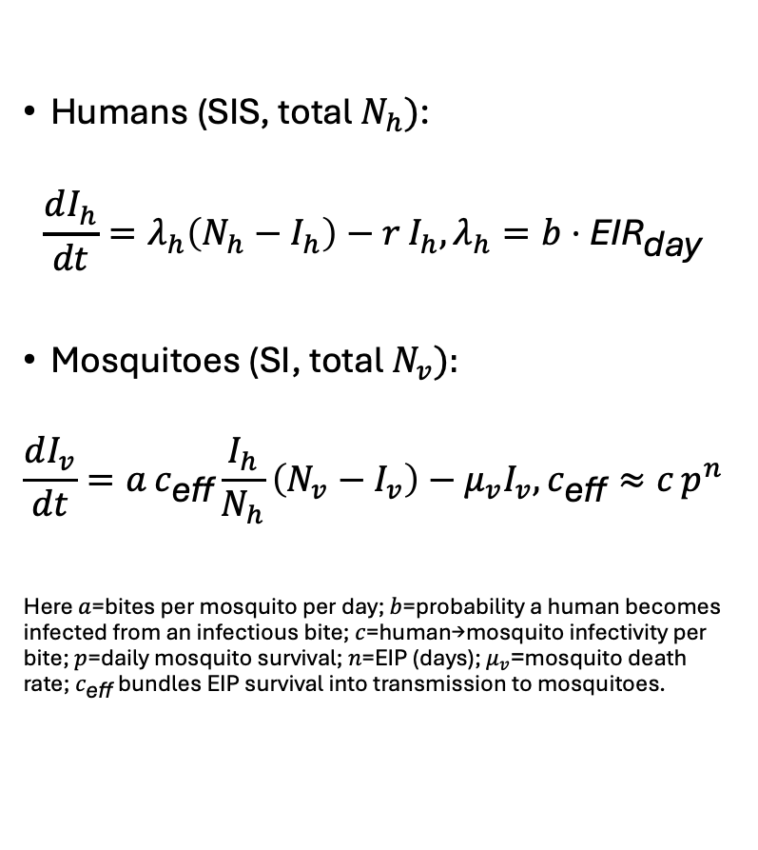
Human–Mosquito Model (minimal)
Humans (SIS, total $N_{h})$:
$$\frac{dI_{h}}{dt}=λ_{h}\left(N_{h}−I_{h}\right)−r I_{h}, λ_{h}=b⋅{\text{EIR}}_{\text{day}}$$
Mosquitoes (SI, total $N_{v}):$
$$\frac{dI_{v}}{dt}=a c_{\text{eff}}\frac{I_{h}}{N_{h}}\left(N_{v}−I_{v}\right)−μ_{v}I_{v}, c_{\text{eff}}≈c p^{n}$$
Here $a$=bites per mosquito per day; $b$=probability a human becomes infected from an infectious bite; $c$=human→mosquito infectivity per bite; $p$=daily mosquito survival; $n$=EIP (days); $μ_{v}$=mosquito death rate; $c_{\text{eff}}$ bundles EIP survival into transmission to mosquitoes.

Slide 5


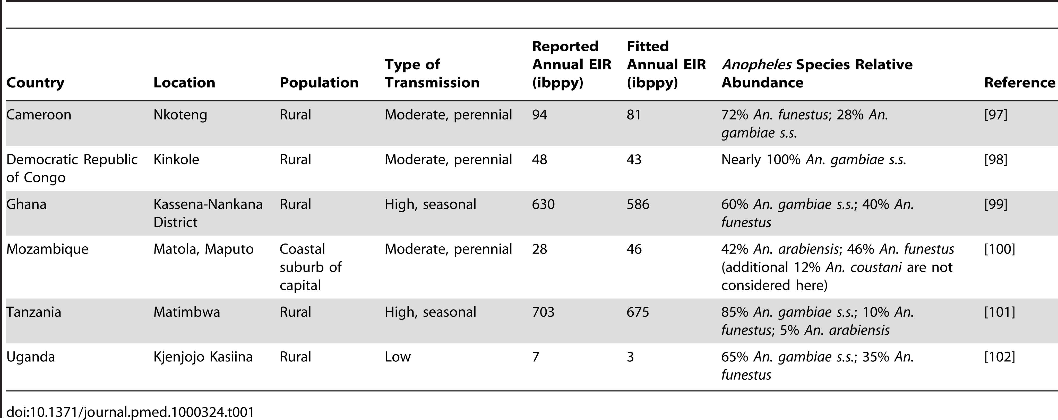
Numbers from literature (and explicit assumptions)

Slide 6

Pulling numbers from literature
Transmission level (site): Choose a moderate setting from Griffin et al. (2010), who summarise six sites by annual EIR (infectious bites/person/year), including ≈ 43 ibppy (moderate). Convert to per day:
${\text{EIR}}_{\text{day}}=43/365.25≈0.118$ infectious bites/person/day.
Human→mosquito infectivity $c$: Smith et al. (2007) use $c=0.5$ as a representative value from direct-feeding studies (naïve hosts).
Mosquito lifespan (for $μ_{v}$): Smith et al. note an average lifespan of 10–20 days, i.e. $μ_{v}∼0.05−1$ per day. We’ll take $μ_{v}=0.1 {\text{day}}^{−1}$(≈10-day average).
These are the only values we assert from the papers; the rest are explicit teaching assumptions to keep the example self-contained.

Slide 7

Minimal parameterisation using EIR (human side)
Because $λ_{h}=b⋅{\text{EIR}}_{\text{day}}$,
choose an illustrative per-bite infection prob. $b=0.05$(assump),
then $λ_{h}≈0.05×0.118≈0.0059 {\text{day}}^{−1}$.
choose a mean infectious duration of 200 days (assump) → $r=1/200=0.005 {\text{day}}^{−1}$.
Equilibrium human prevalence (from SIS with constant $λ_{h})$
$$x_{h}^{\text{\backslash }\text{∗}}=\frac{I_{h}^{\text{\backslash }\text{∗}}}{N_{h}}=\frac{λ_{h}}{λ_{h}+r}=\frac{0.0059}{0.0059+0.005}≈0.54 \left(\text{about} 54\%\right).$$
This shows how EIR + $b$ pins down the force of infection and, together with $r$, fixes the endemic prevalence in a simple SIS.

Slide 8
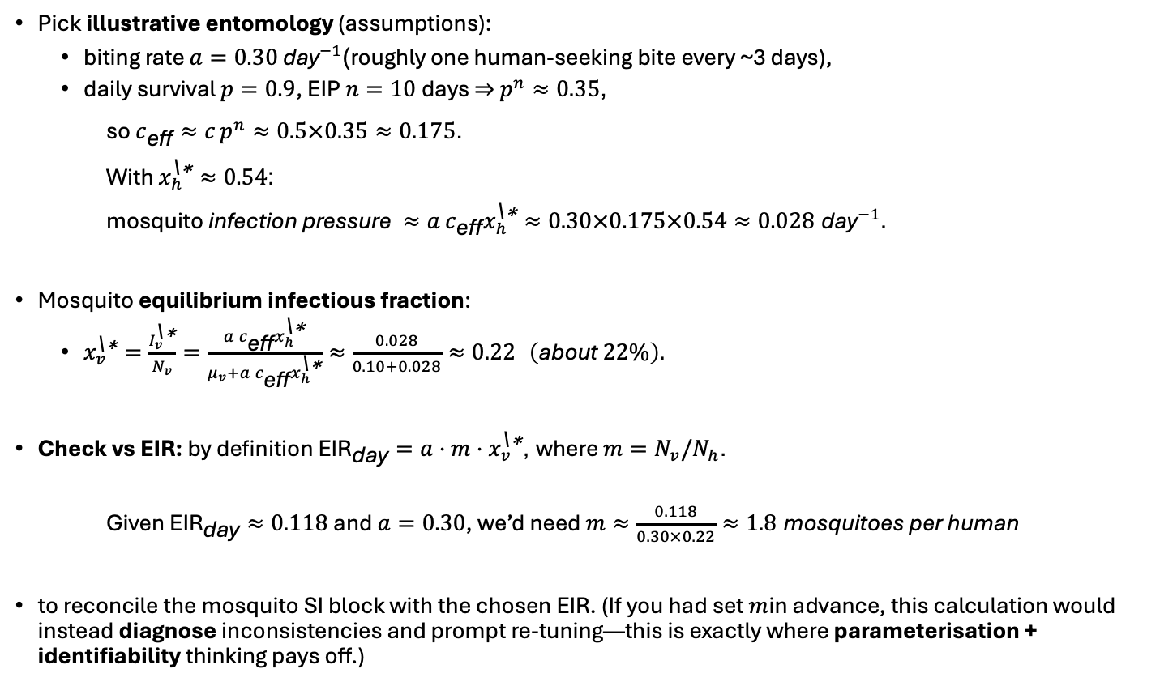
Adding the mosquito SI block (consistency check)
Pick illustrative entomology (assumptions):
  biting rate $a=0.30 {\text{day}}^{−1}$(roughly one human-seeking bite every ~3 days),
  daily survival $p=0.9$, EIP $n=10$days ⇒ $p^{n}≈0.35$,
so $c_{\text{eff}}≈c p^{n}≈0.5×0.35≈0.175$.
With $x_{h}^{\text{\backslash }\text{∗}}≈0.54$:
$\text{mosquito} \text{infection} \text{pressure} ≈a c_{\text{eff}}x_{h}^{\text{\backslash }\text{∗}}≈0.30×0.175×0.54≈0.028 {\text{day}}^{−1}.$
Mosquito equilibrium infectious fraction:
  $x_{v}^{\text{\backslash }\text{∗}}=\frac{I_{v}^{\text{\backslash }\text{∗}}}{N_{v}}=\frac{a c_{\text{eff}}x_{h}^{\text{\backslash }\text{∗}}}{μ_{v}+a c_{\text{eff}}x_{h}^{\text{\backslash }\text{∗}}}≈\frac{0.028}{0.10+0.028}≈0.22 \left(\text{about} 22\%\right).$
Check vs EIR: by definition ${\text{EIR}}_{\text{day}}=a⋅m⋅x_{v}^{\text{\backslash }\text{∗}}$, where $m=N_{v}/N_{h}$.
Given ${\text{EIR}}_{\text{day}}≈0.118$and $a=0.30$, we’d need $m≈\frac{0.118}{0.30×0.22}≈1.8 \text{mosquitoes} \text{per} \text{human}$
to reconcile the mosquito SI block with the chosen EIR. (If you had set $m$in advance, this calculation would instead diagnose inconsistencies and prompt re-tuning—this is exactly where parameterisation + identifiability thinking pays off.)

Slide 9
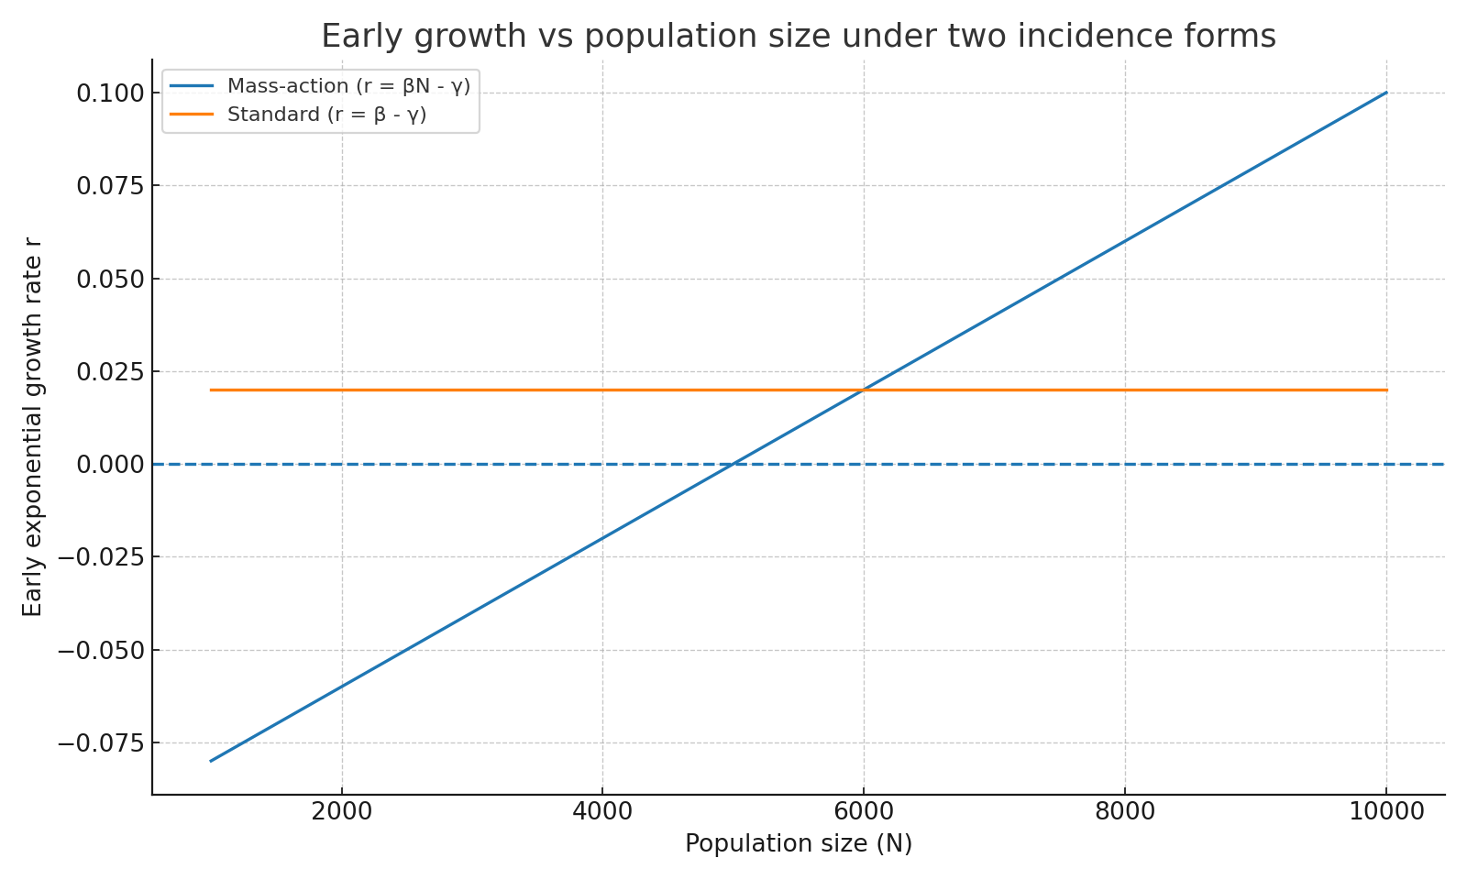
Incidence choice: mass-action vs standard
Mass-action/Force of Infection: λ = β I → r ≈ βN − γ (depends on N).
Standard: λ = β I/N → r ≈ β − γ (independent of N).
β units differ: mass-action 1/(person·time) vs standard 1/time.

Slide 10

Scaling
Idea (why): Remove units and redundant scales so estimation is easier and interpretation is cleaner (fewer, better-behaved parameters).
State scaling: work with prevalence $x=I/N$ instead of counts; keeps $x∈\left[0 , 1\right]$and avoids carrying $N$.
Time scaling: set dimensionless time $τ=γt$(measure time in infectious-period units).
SIS result (standard incidence):
  $$\frac{dx}{dτ}=x\left\{ R_{0}\left(1−x\right)−1 \right\}, R_{0}=β/γ.$$
Only $R_{0}$ and the initial prevalence $x_{0}$remain (plus any measurement params).
Benefits: fewer parameters, improved conditioning (less correlation of $β,γ$), simpler sensitivity/identifiability, easier comparison across settings.

Slide 11
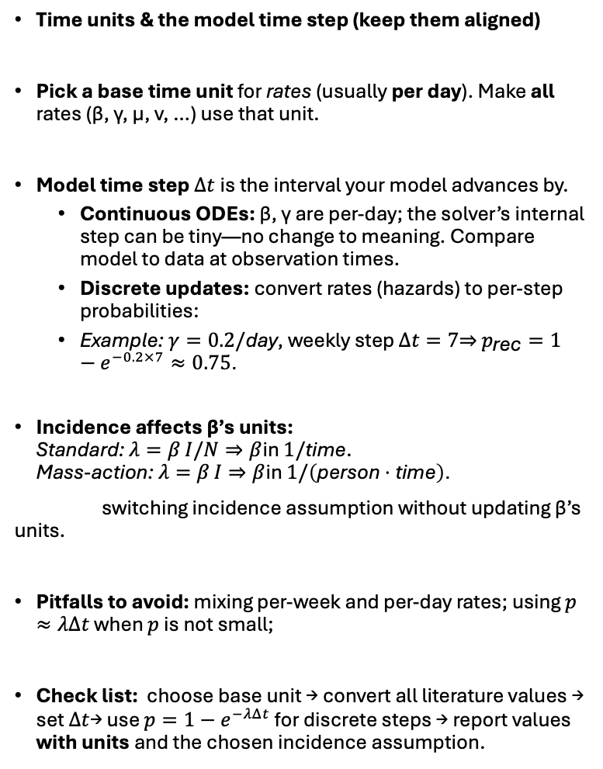
Scaling
Time units & the model time step (keep them aligned)
Pick a base time unit for rates (usually per day). Make all rates (β, γ, μ, ν, …) use that unit.
Model time step $Δt$is the interval your model advances by.
  Continuous ODEs: β, γ are per-day; the solver’s internal step can be tiny—no change to meaning. Compare model to data at observation times.
  Discrete updates: convert rates (hazards) to per-step probabilities:
  Example: $γ=0.2/\text{day}$, weekly step $Δt=7$⇒ $p_{\text{rec}}=1−e^{−0.2×7}≈0.75$.
Incidence affects β’s units:
Standard: $λ=β I/N⇒β$in $1/\text{time}$.
Mass-action: $λ=β I⇒β$in $1/\left(\text{person}⋅\text{time}\right)$.
switching incidence assumption without updating β’s units.
Pitfalls to avoid: mixing per-week and per-day rates; using $p≈λΔt$ when $p$ is not small;
Check list: choose base unit → convert all literature values → set $Δt$→ use $p=1−e^{−λΔt}$ for discrete steps → report values with units and the chosen incidence assumption.

Slide 12

Identifiability
Identifiability asks: Can the data uniquely tell us the parameter values?
In an SIS model with standard incidence, the equilibrium prevalence depends mainly on the ratio $R_{0}=β/γ$.
  So, if your data are only near equilibrium, many $\left(β , γ\right)$pairs with the same ratio fit equally well → a ridge (poor/“practical” identifiability of $β$and $γ$ separately).
If you also observe transient (early) dynamics, the early growth rate $r=β−γ$ plus the ratio $R_{0}=β/γ$ helps pin down $β$and $γ$ much more tightly → better identifiability.
Two parameter sets: $\left(β , γ\right)=\left(0.6 , 0.2\right)$ and $\left(0.3 , 0.1\right)$.
Both have $R_{0}=β/γ=3$→ same equilibrium prevalence
But their growth rates differ: $0.6−0.2=0.4$ vs $0.3−0.1=0.2$ per day.
Result: they look the same at equilibrium, different in early growth.

Slide 13

Identifiability
Structural vs practical vs observability
Is it identifiable in principle (noise-free) vs with real data; can latent states be reconstructed from outputs?
Global vs local identifiability
Unique solution everywhere vs only near the truth; matters for multimodal posteriors.
Parameter confounding & symmetries
Scale/ratio confounds (e.g., $β$–$γ$ via $R_{0}$; $β$–$N$ under mass-action; $β$–contact-matrix scale in age models).
Initial conditions as parameters
$I_{0}$, hidden seeding, or imported cases often confound with $β$; profile $I_{0}$explicitly.
Data regime matters
Equilibrium identifies $R_{0}$; transients add growth $r=β−γ$; interventions/seasonality (amplitude–phase confounding).
Measurement model confounds
Reporting rate $ρ$vs prevalence/scale; overdispersion (beta-binomial) vs process noise; misclassification.
Multiple data streams to break confounds
Cases + serology + prevalence + hospitalization severities; e.g., add serology to separate $ρ$from true incidence.
Design for identifiability
Choose sampling times (early dynamics), increase frequency/size, perturb system (e.g., known intervention).
Remedies
Re-parameterise (e.g., $R_{0}, 1/γ$); fix/bound weak parameters; add informative priors; reduce model dimension; state assumptions.

Slide 14
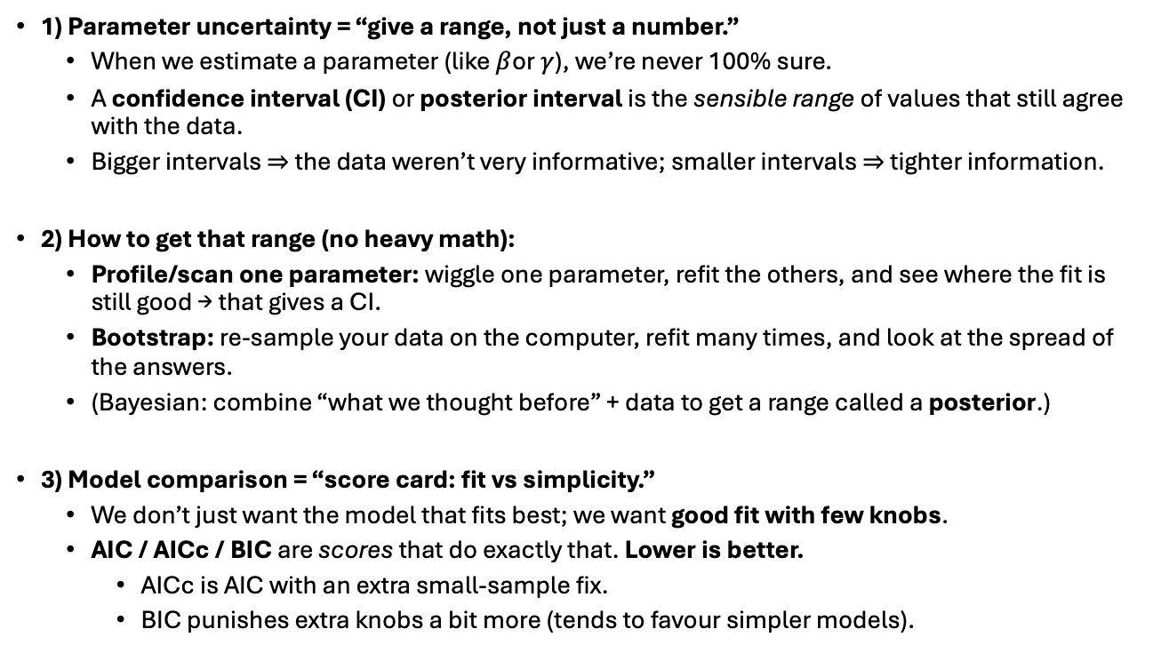
Uncertainty and model selection
1) Parameter uncertainty = “give a range, not just a number.”
  When we estimate a parameter (like $β$or $γ$), we’re never 100% sure.
  A confidence interval (CI) or posterior interval is the sensible range of values that still agree with the data.
  Bigger intervals ⇒ the data weren’t very informative; smaller intervals ⇒ tighter information.
2) How to get that range (no heavy math):
  Profile/scan one parameter: wiggle one parameter, refit the others, and see where the fit is still good → that gives a CI.
  Bootstrap: re-sample your data on the computer, refit many times, and look at the spread of the answers.
  (Bayesian: combine “what we thought before” + data to get a range called a posterior.)
3) Model comparison = “score card: fit vs simplicity.”
  We don’t just want the model that fits best; we want good fit with few knobs.
  AIC / AICc / BIC are scores that do exactly that. Lower is better.
    AICc is AIC with an extra small-sample fix.
    BIC punishes extra knobs a bit more (tends to favour simpler models).

Slide 15

R practical (scaling)
Download: mixing_units_practical.R
What it does:
Starts from a weekly recovery probability $p_{\text{week}}=0.7$.
Computes the correct daily rate , and two common mistakes:
  Naive: $γ≈p_{\text{week}}/7$(linear approx—bad when $p$is large).
  Wrong: use $0.7$as if it were a daily rate (very wrong).
Simulates an SIS model (standard incidence), generates weekly prevalence data, and compares:
  Early growth $r=β−γ$, doubling time, and
  Fit quality (Binomial NLL) and trajectories for the correct vs the two mistaken versions.

Slide 16
Discussion

